Slide 1

LOGIC & PROBLEM SOLVING
COURSE

Slide 2



REFLEXION
20 MIN
What should be your behavior in this course ?
- 5 post it = 5 ideas
What should be the teacher behavior in this course ?
- 5 post it = 5 ideas
TO COMPLETE THIS ACTIVITY :
1
DISCUSS IN TEAM
2
1 STUDENT STICKS POST IT ON WHITE BOARD
10 min
10 min
Notes:
Example of student expectations in class :
Be curious, ask question, help each other, express, talk, don t be shy to ask question..
Example of teacher expectations in class :
Be clear, Be consistent, Be respectful

Slide 3



NOTE TAKING
DURING THE CLASS
AFTER THE CLASS
QUICK NOTES
ON YOUR DRAFT NOTEBOOK
CLEAN NOTES
ON YOUR BCU NOTEBOOK

Slide 4
Course plan
JAN
FEV
MAR
APR
MAY
Work in a team
Problem solving process
Problem
Solving

Slide 5
Course plan
JAN
FEV
MAR
APR
MAY
Encode images, strings, numbers
Write in binary / hexadecimal base
Add/subtract binary numbers
Solve encoding games
Encoding
Work in a team
Problem solving process
Problem
Solving

Slide 6
Course plan
JAN
FEV
MAR
APR
MAY
Evaluate a Boolean expression
Write a Boolean expression
Use Boolean operators
Write a truth table
Write conditional trees
Logic
Encode images, strings, numbers
Write in binary / hexadecimal base
Add/subtract binary numbers
Solve encoding games
Encoding
Work in a team
Problem solving process
Problem
Solving

Slide 7

Course evaluation
10 %
PARTICIPATION IN CLASS
10 %
HOMEWORKS & Quiz
30 %
MIDTERM EXAM
50 %
FINAL EXAM

Slide 8

ACTIVITY
30 MIN
Build the highest tower
REFLECTION
TOWER 1 - PLAN
TOWER 1 - TEST
TOWER 2 - PLAN
TOWER 2 - TEST
You will build 2 towers
Paper only
Tower shall stand for at least 30 seconds
You need to improve your design between the first and second
After each tries, write your reports on the document
Notes:
Develop a Plan
Give students a couple minutes to discuss in groups the approach they will be taking with this first tower. Once groups have recorded their ideas and some possible weaknesses they can come to you to get their paper and begin building their towers.
Test Your Tower
Once groups are ready, have them test their towers by recording its height and see if it can stand on its own. Remind them of the rules, specifically that they can't touch or adjust the towers once they let go of it.
Evaluate and Improve
This first attempt at building our towers was just to get familiar with the challenge. We're all going to build a second tower and see if we can improve the height of our tower without having it fall. Before we get started though, let's see what we can learn from this trial run.
Try gain
Now that you've had a chance to learn from the first round of tower making, let's run the same activity again. First, your group will develop a new plan. Just as before, record it on your activity guide, and once you're ready I'll come around and give you more paper.
Support: As you circulate from group to group, ask questions about the group’s focus in redesign. EX: “What aspect of your tower needed the most improvement?” “What ideas from other groups did you want to incorporate to yours?” “Did you feel the need to completely rebuild your tower, or make minor modifications?”
Once groups have prepared their new plans give them new pieces of paper and have them each build a new tower.

Slide 9

REFLEXION
10MIN
How to efficiently solve problems in team?
INSTRUCTIONS
10 minutes to discuss in teams
Find 4 ideas and write each idea on 1 POST IT
Each speaker put the post it on whiteboard
Group by categories
BONUS
Can you find an SEQUENCE of STEPS as a process to solve problem in teams ?
Notes:
Possible answers:
collaboration brings more ideas
We can slit up the tasks
Problems
Group dynamic
Improvements
How to work together more effectively

Slide 10
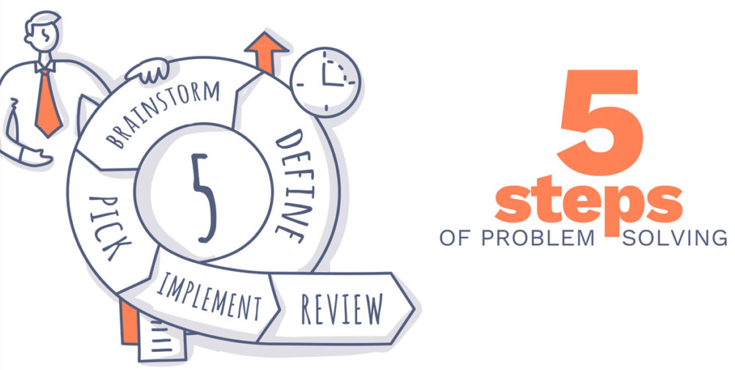

Slide 11
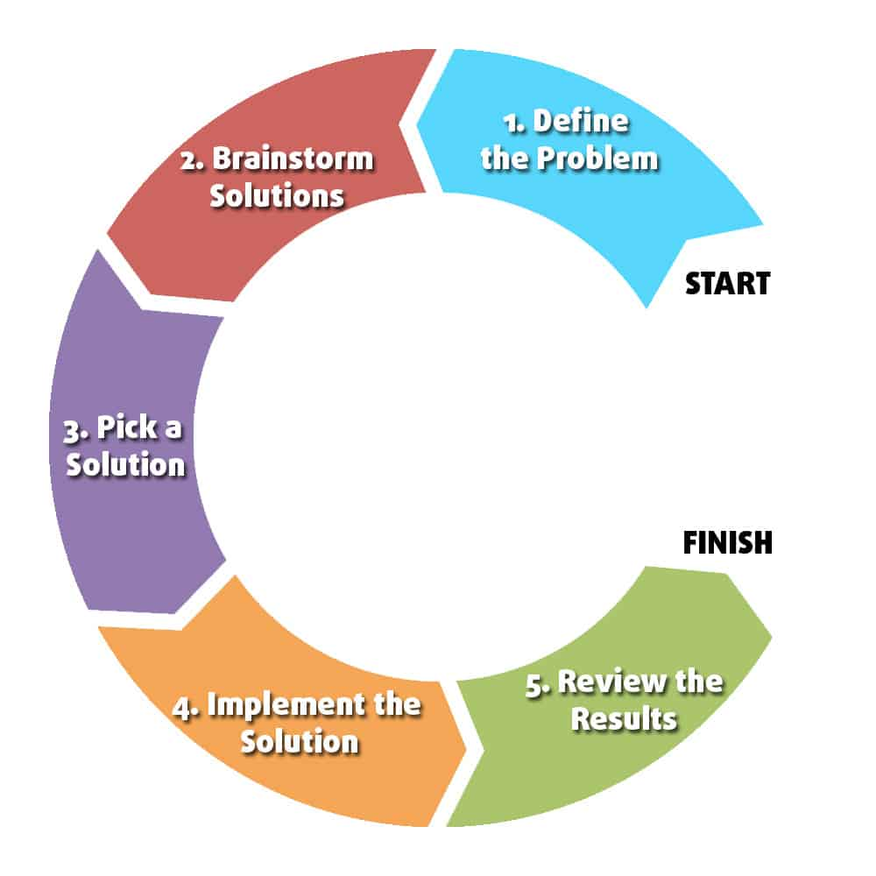
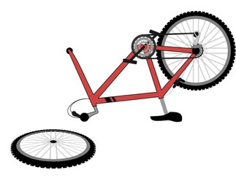
ACTIVITY
You broke your bike…
30 MIN
Describe your actions to solve this problem
Where do you put each action on the below 5 steps process ?

Slide 12
REFLEXION
Which steps do you prefer? Why ?
ALL
5 MIN
Find lost of solutions
Decide which solution to use
Implement a solution
Validate a solution

